Slide 1
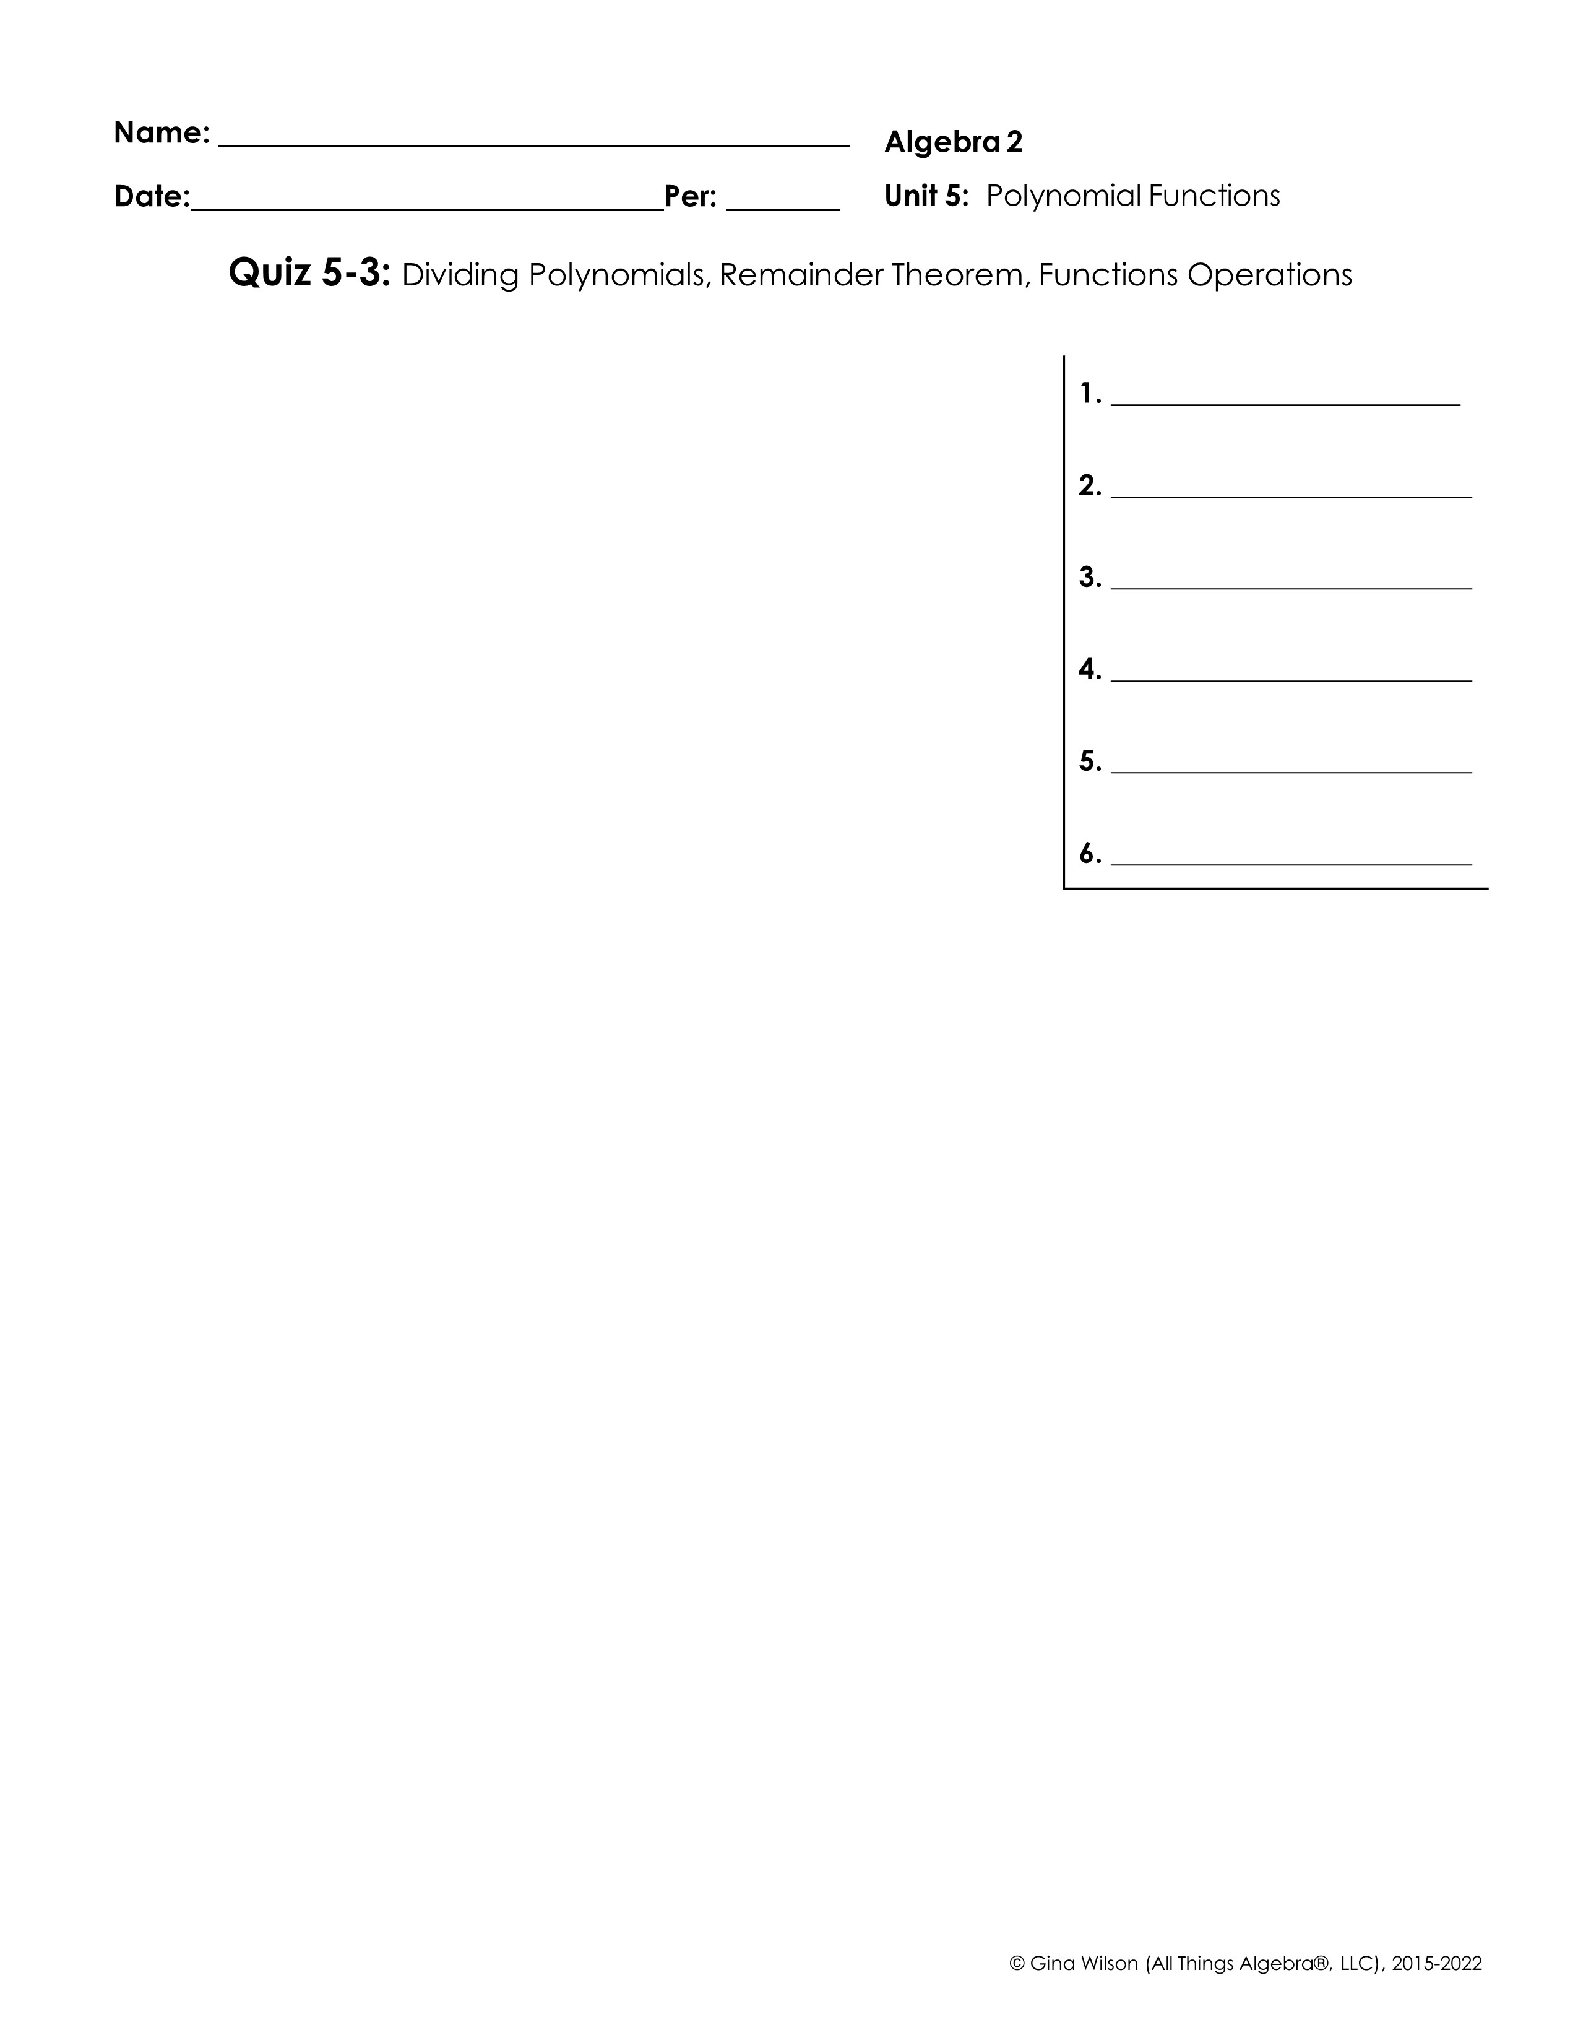
Find each quotient.
1.
2.
3.
4.
5.
6.

Slide 2

7. If f(x) = 3x⁴ – 8x³ + 14x – 29, use the Remainder Theorem to find f (2).
8. The population P of an endangered species can be modeled by the function P(t) = -x³ + 32x² – 50x + 450, where t is the years since 2010. Use the Remainder Theorem to find the population of the species in 2024.
Given f(x) = x + 5, g(x) = x² – 9, and h(x) = x² – 10x + 7, find each function. State any restrictions in the domain.
9.
10.
11.
12.
Find each function value.
13.
14.

